Slide 1
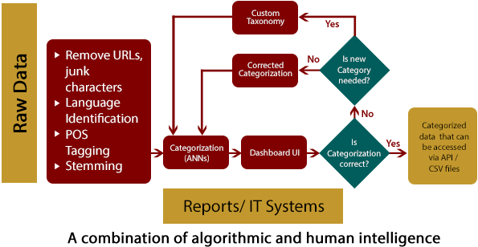
Mu Sigma helped a technology giant to automate categorization of engageable and non- engageable mentions
Online Mentions
Business Case
Methodology
The client is one of the largest software technology companies in the world
It manually buckets Twitter user posts as engageable and non-engageable, and uses significant bandwidth for the process
Requirements: An automated framework that
Processes and categorizes user posts at a higher frequency while maintaining accuracy
Is cheaper than the existing solution
Is flexible and can learn from feedback
Is scalable and can be extended to other social platforms with ease
muFusion required visibility around guidelines based on which the user posts are categorized
The categorization framework was integrated with a third party platform to display workflow for engagement managers
muFusion categorization also classifies large volume of mentions with greater accuracy
The automated process covers inbound volume of mentions on weekends as well
The new framework has reduced manual effort so that community managers can engage with end users more
Analytical Framework
Business Impact
Mu Sigma leverage its social media intelligence platform – muFusion Social for performing the analysis
The categorization framework helped client improve overall productivity by more than 60%:
Categorized relevant mentions at higher scale and accuracy
Community managers have more bandwidth to focus on engagements with end users
muFusion framework helped client save about 40% on costs compared to the manual process
Raw Data

